Slide 1
Homework 0

Slide 2
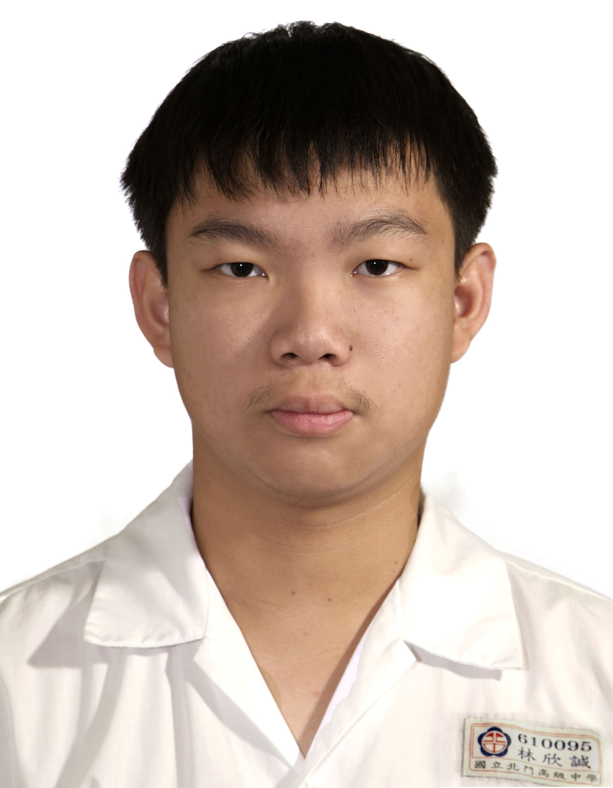
計算機組織學生資料
姓名：林欣諴
科系： 資訊工程
學號：F74094083
年級：大二
手機： 0984359336
為何修這門課(多選)？
這是必修課，不得不選
想了解電腦內部的架構

Slide 3
Background Survey
Have you taken “Introduction to circuits theory and digital electronics” ?
□ Yes. My grade is __76__ □ No.
Have you taken “Introduction to digital system”
□ Yes. My grade is __91__ □ No.
Have you taken “Lab for Introduction to digital system”
□ Yes. My grade is __89__ □ No.
How many hours have you spent learning Verilog?
_____30_______ hours
Write any thing that you want Prof. Lin to know:
因為我們沒有學過計算機概論，所以對於電腦上的硬體部分可能會有點不熟悉，希望老師有機會的話可以對那邊稍微做講解

Slide 4
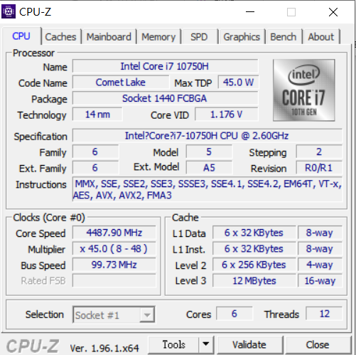
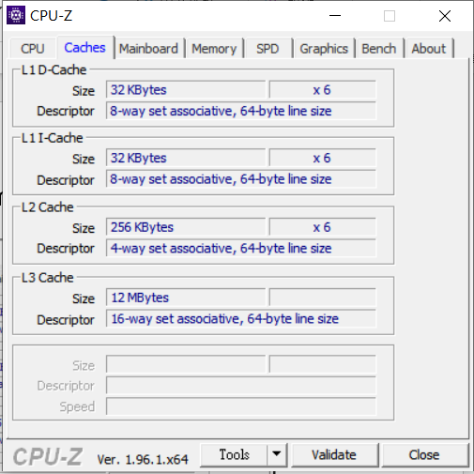
Know your computer
Information for CPU
Information for Caches
L1 D-cache: 6x 32 KB, 8 way set associate, 64-byte line size
L1 I-cache: 6x 32 KB, 8 way set associate, 64-byte line size
L2 cache: 6x 256 KB, 4 way set associate, 64-byte line size
L3 cache: 12MB, 16 way set associate, 64-byte line size
CPU name: Intel Core i7 10750H, TDP: 45W,
Technology: 14nm, VID: 1.176V
Core speed: 4487.9MHz

Slide 5
Answer the following questions (You can use google to search)
CPU name: Intel Core i7 10750H
TDP: 45W
Technology: 14nm
VID: 1.176V
Core speed: 4487.9MHz
L1 D-cache: 6x 32 KB, 8 way set associative, 64-byte line size
L1 I-cache: 6x 32 KB, 8 way set associative, 64-byte line size
L2 cache: 6x 256 KB, 4 way set associative, 64-byte line size
L3 cache: 12 MB, 16 way set associative, 64-byte line size

Slide 6
What is the difference between L1 D-Cache and L1 I-Cache?
D-cache包含指令操作的資料
I-cache包含需要執行的指令
What is the meaning of “set associative”
集合相聯，將區塊再透過集合分組

